Slide 1
APEX case for beam time
Well optimized: LW/F is best for E_{A}/E_{beam} near 1, for a’ > 10⁻⁷
Will cover a wide mass range with 30-100 higher sensitivity
Test run showed that the experimental setup works
Ready to run with full L except possible 30% reduction for 3.3 GeV part
Analysis code for the wire chamber needs more work to boost HRS-L efficiency > 60%
Iron beam line inside the septum magnet needs to be designed and constructed
Target foil holders (and foils) for each kinematic setting needs to be constructed
Completion of Test Run analysis (publication)
Collaboration has required resources, need new HW ~ $25k

Slide 2
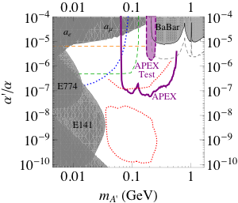
APEX case for beam time
APEX is ready to take data on 1-2 months notice
APEX could be the first experiment of A’ search program at Jlab

